Slide 1
AWS Security, Monitoring, and Cost Optimization Best Practices for Cloud
Pranjal Srivastava

Slide 2
Welcome & Agenda
Today’s Goals:
- Understand AWS security fundamentals
- Learn to monitor cloud resources effectively
- Discover cost optimization techniques and tools

Slide 3
Why AWS Security, Monitoring, and Cost Optimization Matter
Cloud misuse and misconfiguration are top security risks
Cost overruns are common without active monitoring
Downtime and data breaches damage reputation and finances
AWS offers powerful tools—but they must be configured correctly
Focus on security, visibility, and efficiency = success in the cloud

Slide 4
AWS Shared Responsibility Model
AWS is responsible for:
- Security of the cloud (hardware, networking, data centers)
You are responsible for:
- Security in the cloud (data, access, apps, configurations)
Key shared areas:
- Patching OS and middleware (varies by service model)
- Identity and access management
Understanding boundaries is critical for compliance and security

Slide 5
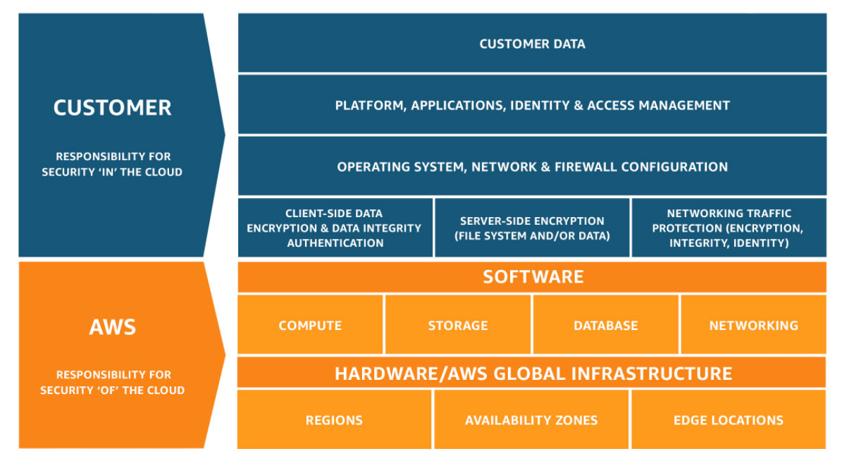
Source: AWS

Slide 6
Identity and Access Management (IAM)
Central service to manage access to AWS resources
Supports users, groups, roles, and policies
Use roles instead of access keys when possible
Integrates with other AWS services (S3, EC2, Lambda, etc.)
Free service; part of the AWS global infrastructure

Slide 7
IAM Best Practices
Apply Principle of Least Privilege: only necessary access
Avoid using root account for daily tasks
Use IAM roles for applications instead of hardcoded credentials
Enable Multi-Factor Authentication (MFA) on critical accounts
Rotate access keys regularly and avoid long-term credentials
Use IAM policies with conditions (e.g., IP-based restrictions)

Slide 8
Data Protection and Encryption
Protect data at rest and in transit
Use AWS KMS (Key Management Service) for encryption key control
Enable default encryption for S3, EBS, RDS, and others
Use SSL/TLS for secure data transmission
Manage secrets with AWS Secrets Manager or Parameter Store

Slide 9
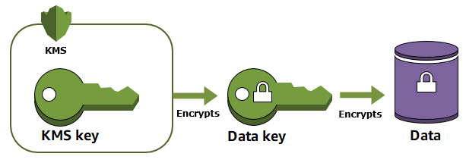
AWS KMS

Slide 10
Securing S3 Buckets
Block public access settings—apply at bucket and account level
Enable encryption at rest with S3-managed or KMS keys
Use bucket policies and IAM policies together
Enable versioning and object lock for protection
Monitor access logs and configure CloudTrail integration

Slide 11
Network Security: VPC, Security Groups, and NACLs
Use VPC to define network boundaries
Security Groups:
- Stateful, instance-level firewalls
- Allow only required inbound/outbound ports
Network ACLs:
- Stateless, subnet-level rules
- Good for blocking IPs or ranges
Use private subnets for sensitive services
Enable VPC Flow Logs to monitor network traffic

Slide 12
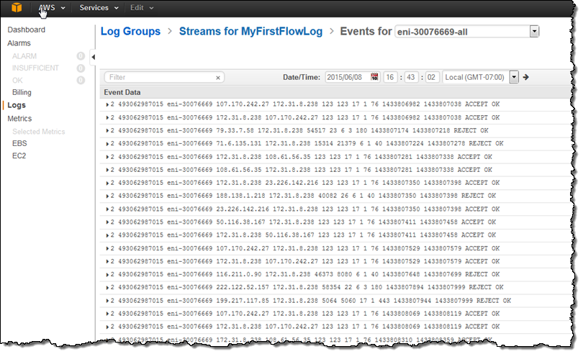
VPC FLOW LOG

Slide 13
Monitoring and Auditing with CloudTrail & Config
AWS CloudTrail:
- Tracks API calls across AWS services
- Captures who did what, when, and from where
- Can store logs in S3 for auditing
AWS Config:
- Records configuration changes to AWS resources
- Evaluates compliance against predefined rules
- Helps with security auditing and troubleshooting

Slide 14
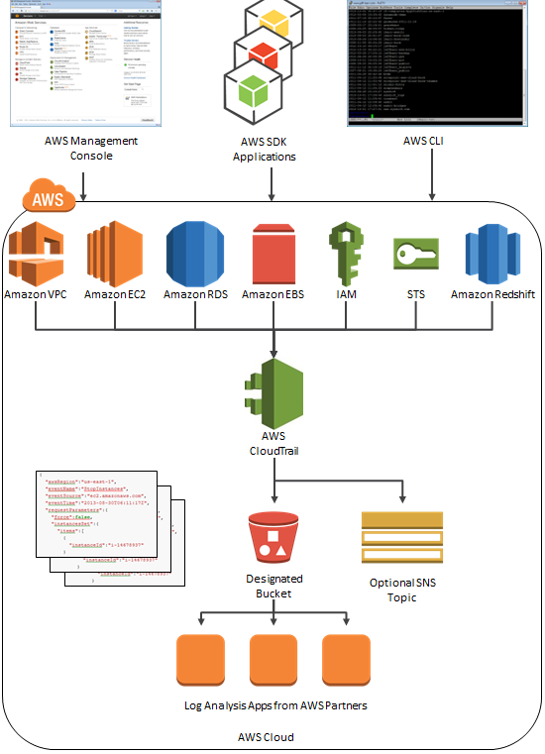
AWS CloudTrail records and logs every API call made on your AWS account, providing a detailed history of all actions taken. This includes who made the call, what time it was made, the source IP address, the request parameters, and the response elements

Slide 15
Using AWS WAF, Shield, and Security Hub
AWS WAF:
- Protects against common web attacks (SQLi, XSS)
- Custom rules + managed rule sets
AWS Shield:
- DDoS protection (Standard: automatic; Advanced: paid tier)
- Integrated with CloudFront, Route 53, etc.
AWS Security Hub:
- Aggregates findings from GuardDuty, Inspector, etc.
- Centralized view of security posture and compliance

Slide 16
Exercise: Create a Least Privilege IAM Policy
Go to IAM → Policies → Create Policy
Use JSON to define access to only one S3 bucket
Attach policy to a role or user
Test access with allowed and denied actions

Slide 17
Exercise: Enable MFA for Root/IAM User
Go to IAM → Users → Select user → Security credentials
Choose 'Assign MFA device'
Select “Virtual MFA device” (e.g., Google Authenticator)
Scan QR code and verify with 2 codes
Enable and confirm MFA is working

Slide 18
Exercise: Block Public Access to an S3 Bucket
Create a new S3 bucket and upload a test file
Go to 'Permissions' tab → Block Public Access settings
Ensure all four options are enabled
Try accessing object URL—should be denied
Review bucket policy and public access settings

Slide 19
AWS Monitoring Services Overview
Amazon CloudWatch: Metrics, logs, alarms, dashboards
AWS CloudTrail: Tracks API activity
AWS Config: Monitors resource configurations and compliance
AWS X-Ray: Traces application requests
AWS Health Dashboard: Shows service outages and personalized alerts

Slide 20
Amazon CloudWatch: Metrics, Logs, Alarms
Collect metrics from EC2, RDS, Lambda, etc.
Create CloudWatch Logs groups for applications
Set alarms for thresholds (e.g., CPU > 80%)
Use CloudWatch Dashboards for visibility
Optionally send alerts via SNS or Lambda automation

Slide 21
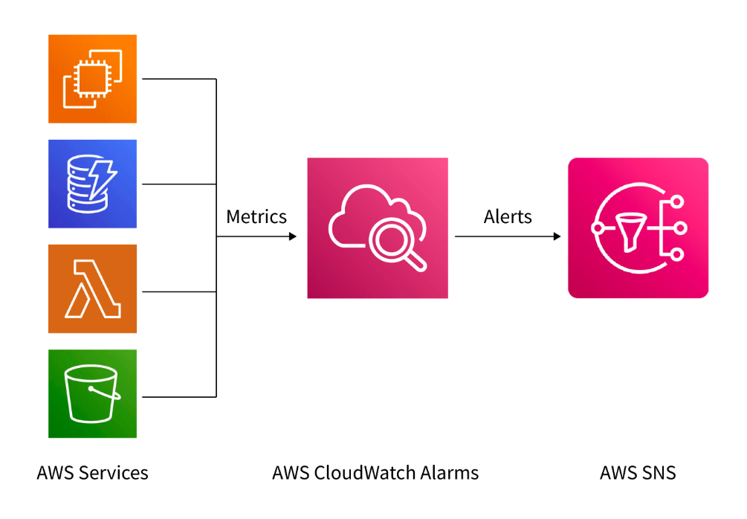
AWS CloudWatch

Slide 22
AWS CloudTrail and Config for Auditing
CloudTrail logs create/modify/delete actions
Critical for forensic investigations and compliance
Config detects non-compliant resource states
Use managed rules or custom Config Rules
Provides continuous visibility into resource changes

Slide 23
X-Ray for Distributed Tracing
AWS X-Ray helps visualize requests across microservices
Trace flow of requests in serverless or container-based apps
Identify bottlenecks and errors in:
- Lambda functions
- ECS/EKS containers
- API Gateway
Provides end-to-end latency and performance insights
Useful for debugging complex architectures

Slide 24
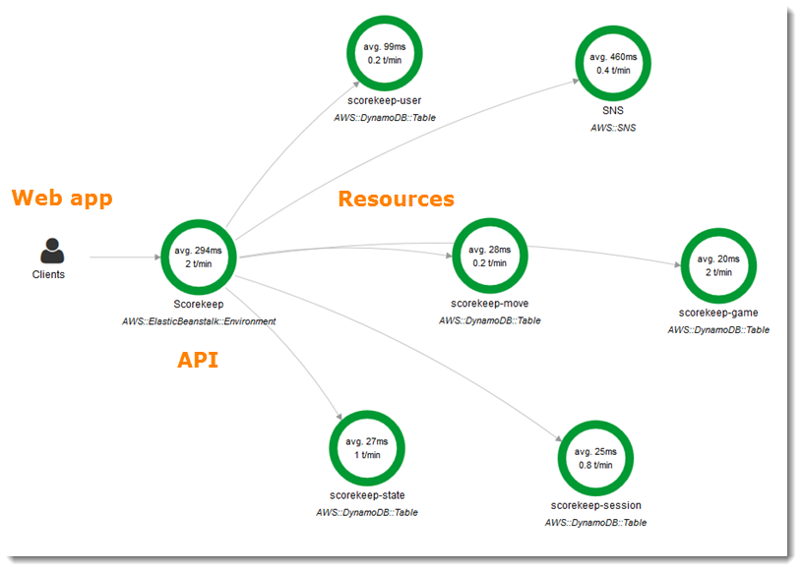
AWS XRAYs

Slide 25
Building Dashboards and Alerts
Use CloudWatch Dashboards for centralized monitoring
- Add widgets: graphs, numbers, alarms
- Track CPU, memory (custom), latency, error rates
Set Alarms to trigger actions:
- SNS notifications
- Auto-scaling events
- Lambda for custom responses
Use dashboards to monitor services by environment (prod/dev)

Slide 26
Exercise: Create a CloudWatch Alarm for EC2
Go to CloudWatch → Alarms → Create Alarm
Choose EC2 → Select instance → Metric: CPUUtilization
Set threshold: greater than 70%
Set evaluation period: 1 or 5 minutes
Add notification (SNS topic) or skip for demo
Alarm will turn red if condition is met

Slide 27
Exercise: Enable and View CloudTrail Logs
Go to CloudTrail → Trails → Create trail
Enable management events (read/write)
Choose new S3 bucket for log delivery
Perform actions (e.g., stop EC2 instance)
Go to S3 → View JSON logs → Confirm your action was logged

Slide 28
Overview: AWS Pricing Models
On-Demand:
Pay by the second/hour
No commitment
Reserved Instances (RI):
1- or 3-year commitment
Significant discount (up to 72%)
Savings Plans:
Commit to spend per hour, across instance types/regions
Spot Instances:
Spare capacity at up to 90% discount
Good for fault-tolerant, flexible workloads

Slide 29
Right-Sizing with Compute Optimizer
Analyze resource usage and suggest changes
Services: EC2, Lambda, EBS, Auto Scaling groups
Suggestions:
- Downsize underutilized instances
- Change instance family or type
Integrates with Cost Explorer for savings visualization
Based on actual performance metrics over 14+ days

Slide 30
Using Reserved Instances and Savings Plans
Reserved Instances:
- Best for predictable workloads (EC2, RDS)
- Choose term, instance type, and AZ
Savings Plans:
- More flexible than RI
- EC2 + Fargate + Lambda
Combine with tagging to align commitments with project budgets
Use Cost Explorer to track utilization

Slide 31
Spot Instances for Cost-Effective Workloads
Leverage spare AWS capacity at steep discounts
Interruptible with 2-minute warning
Ideal for:
- Batch jobs
- Data processing
- CI/CD builds
- Containerized workloads with retry logic
Use Spot Fleet or EC2 Auto Scaling with mixed instance types

Slide 32
Resource Cleanup and Auto Scaling
Unused resources = wasted money
- Orphaned EBS volumes, Elastic IPs, old AMIs
- Idle EC2 instances or underutilized RDS
Automate cleanup with Lambda or AWS Config rules
Use Auto Scaling to match demand
- EC2, ECS, DynamoDB, Aurora
Turn off dev/test environments outside working hours

Slide 33
Tagging for Cost Allocation
Use resource tags to track usage by:
- Project
- Environment
- Department
- Owner
Example tags: Project=AppX, Environment=Prod, Owner=DevTeam1
Use Cost Allocation Tags in Cost Explorer and Budgets
Helps with chargebacks and budgeting

Slide 34
Exercise: Explore AWS Cost Explorer
Go to Billing → Cost Explorer → Launch
View usage by:
- Service (e.g., EC2, S3)
- Linked accounts
- Time period
Group by tag or region
Identify trends, spikes, and cost drivers

Slide 35
Exercise: Create a Budget Alert
Go to AWS Budgets → Create budget
Choose 'Cost Budget'
Set a threshold (e.g., $10)
Add email notification
Use tags or linked accounts to target specific resources

Slide 36
Exercise: Review EC2 Rightsizing Recommendations
Go to AWS Compute Optimizer
Select EC2 instances
View:
- Over-provisioned instances
- Recommended instance types
- Estimated monthly savings
Optionally review Lambda and EBS recommendations

Slide 37
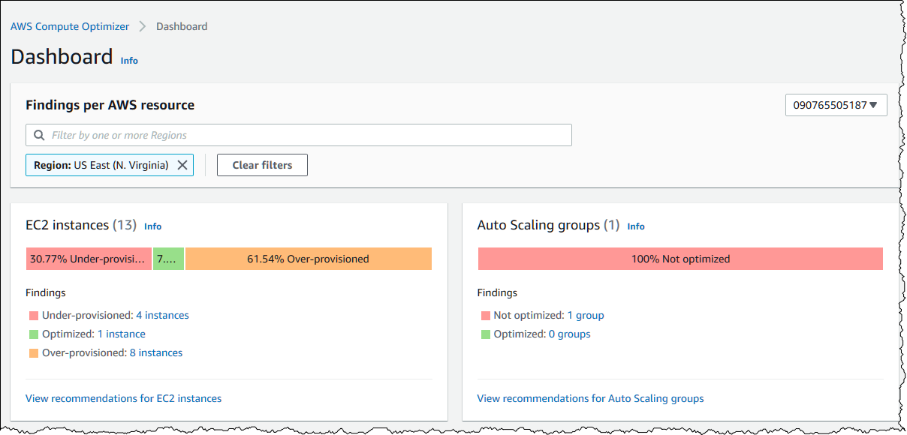

Slide 38
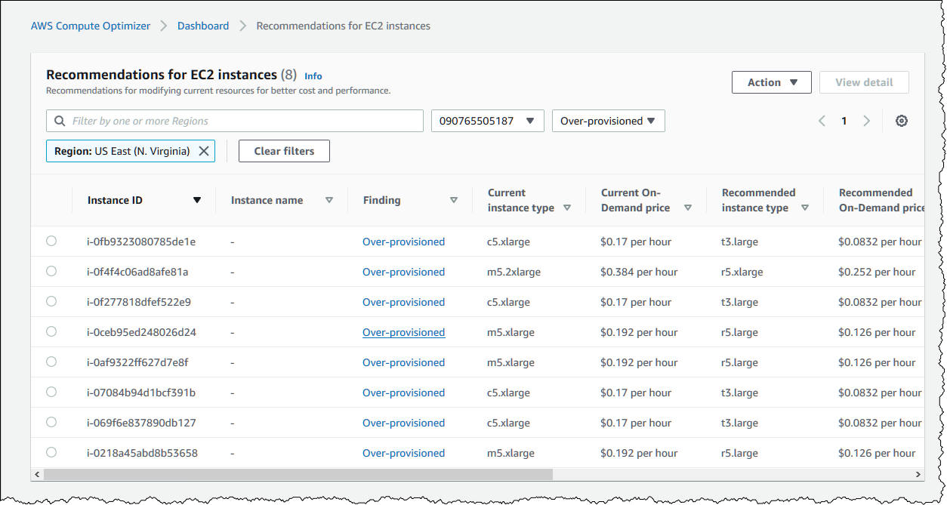

Slide 39
Best Practices Recap
✅ Security:
- Least privilege, MFA, encryption, auditing
✅ Monitoring:
- CloudWatch, CloudTrail, Config, dashboards
✅ Cost Optimization:
- Right-sizing, Spot Instances, budgets, tagging
Use Trusted Advisor and Security Hub regularly
Review and improve continuously

Slide 40
Free Tools: Trusted Advisor, Budgets, Cost Explorer
AWS Trusted Advisor:
- Checks for security gaps, cost savings, performance issues
AWS Budgets:
- Alerts on usage and spending
AWS Cost Explorer:
- Visualize and analyze cost trends
All are part of AWS Free Tier (some limits apply)

Slide 41
Resources and Next Steps
AWS Well-Architected Tool
AWS Disaster Recovery strategies

